Slide 1
Relations & Functions
Algebra 1/domain & range

Slide 2
Objectives
Understand that a relation is a function if each element of domain is assigned to exactly one element in the range.
Determine a reasonable domain & range and identify constraints on the domain based on the context of a real-world problem.

Slide 3
What is a relation
Relationship between sets of information.
Example: If we group everyone in this class according to their height in relation to their name or hair color in relation to their name.

Slide 4
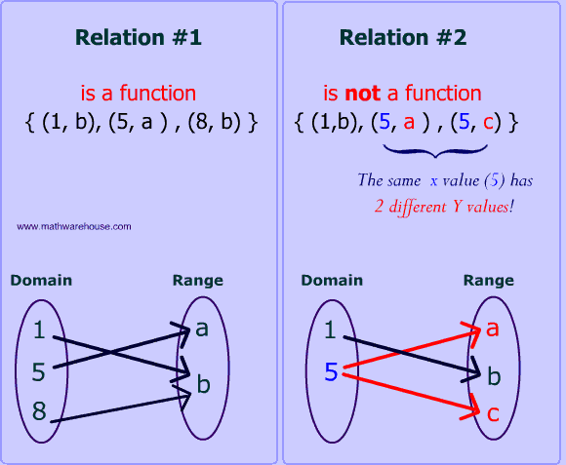
EQ: What is a function?
A function is a relation for which each input has exactly one output
Input = x-value = independent variable
Output = y-value = dependent variable

Slide 5
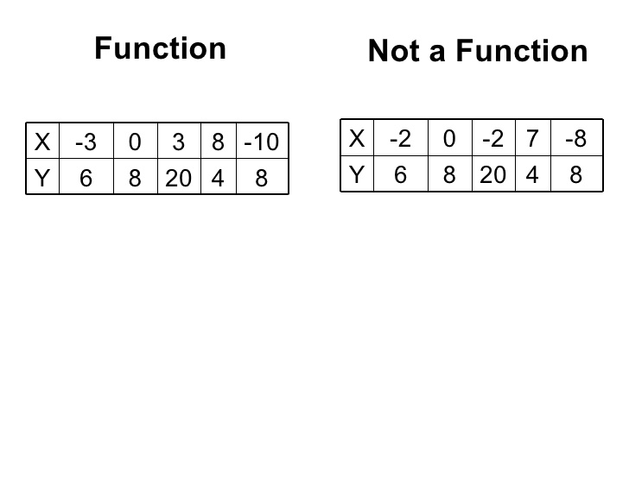
Think about there being one Queen for every one King!! It’s not a function if the Queen has more than one King.

Slide 6
example
(314)546-8679 Rhonda
(213)456-2354 Kelly
(452)672-1290 Robert
(314)5091278 Forester
(345)341-3478 Drake
(212)876-3476 Karen
Is is possible to dial Karen’s number and get Robert on the phone? How?

Slide 7
Input/Output
When you hear input & output, think of the coordinate point (x,y); where x=input and y=output.
When you put in x-value, you get out y-value.

Slide 8
Domain & Range
Domain is your x-value(input)
Range is your y-value(output)
X | 1 | 2 | 3 | 4 | 5
Y | 11 | 12 | 13 | 14 | 15

Slide 9
Examples
Example 1/page 89
Student’s Do:
Identify the domain & Range of each function
A.
B.
X | 2 | 5 | 9
Y | 3 | 7 | 8
X | 4 | 6 | 8
Y | 2 | 3 | 5

