Slide 1
Compound Inequalities
Algebra I
Ms. Wiggins

Slide 2
Standards Addressed
HSA.CED.A.1 Create equations and inequalities in one variable and use them to solve problems.
HSA.CEDA.3 Represent constraints by equations or inequalities, and by systems of equations and/or inequalities, and interpret solutions as viable or nonviable options in a modeling context.
HAS.REI.B3 Solve linear equations and inequalities in one variable, including equations with coefficients represented by letters.

Slide 3
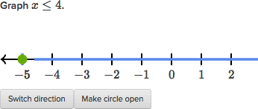
Do Now
Label the three items below as a graph, inequality or compound inequality.
X $>4$
4 $<x <10$

Slide 4
Objective
Students will be able to create and solve a system of inequalities. Interpret the solution to a compound inequality within a modeling context.

Slide 5
Essential Understanding
A compound inequality is a combination of two or more inequalities used to describe multiple constraints.

Slide 7
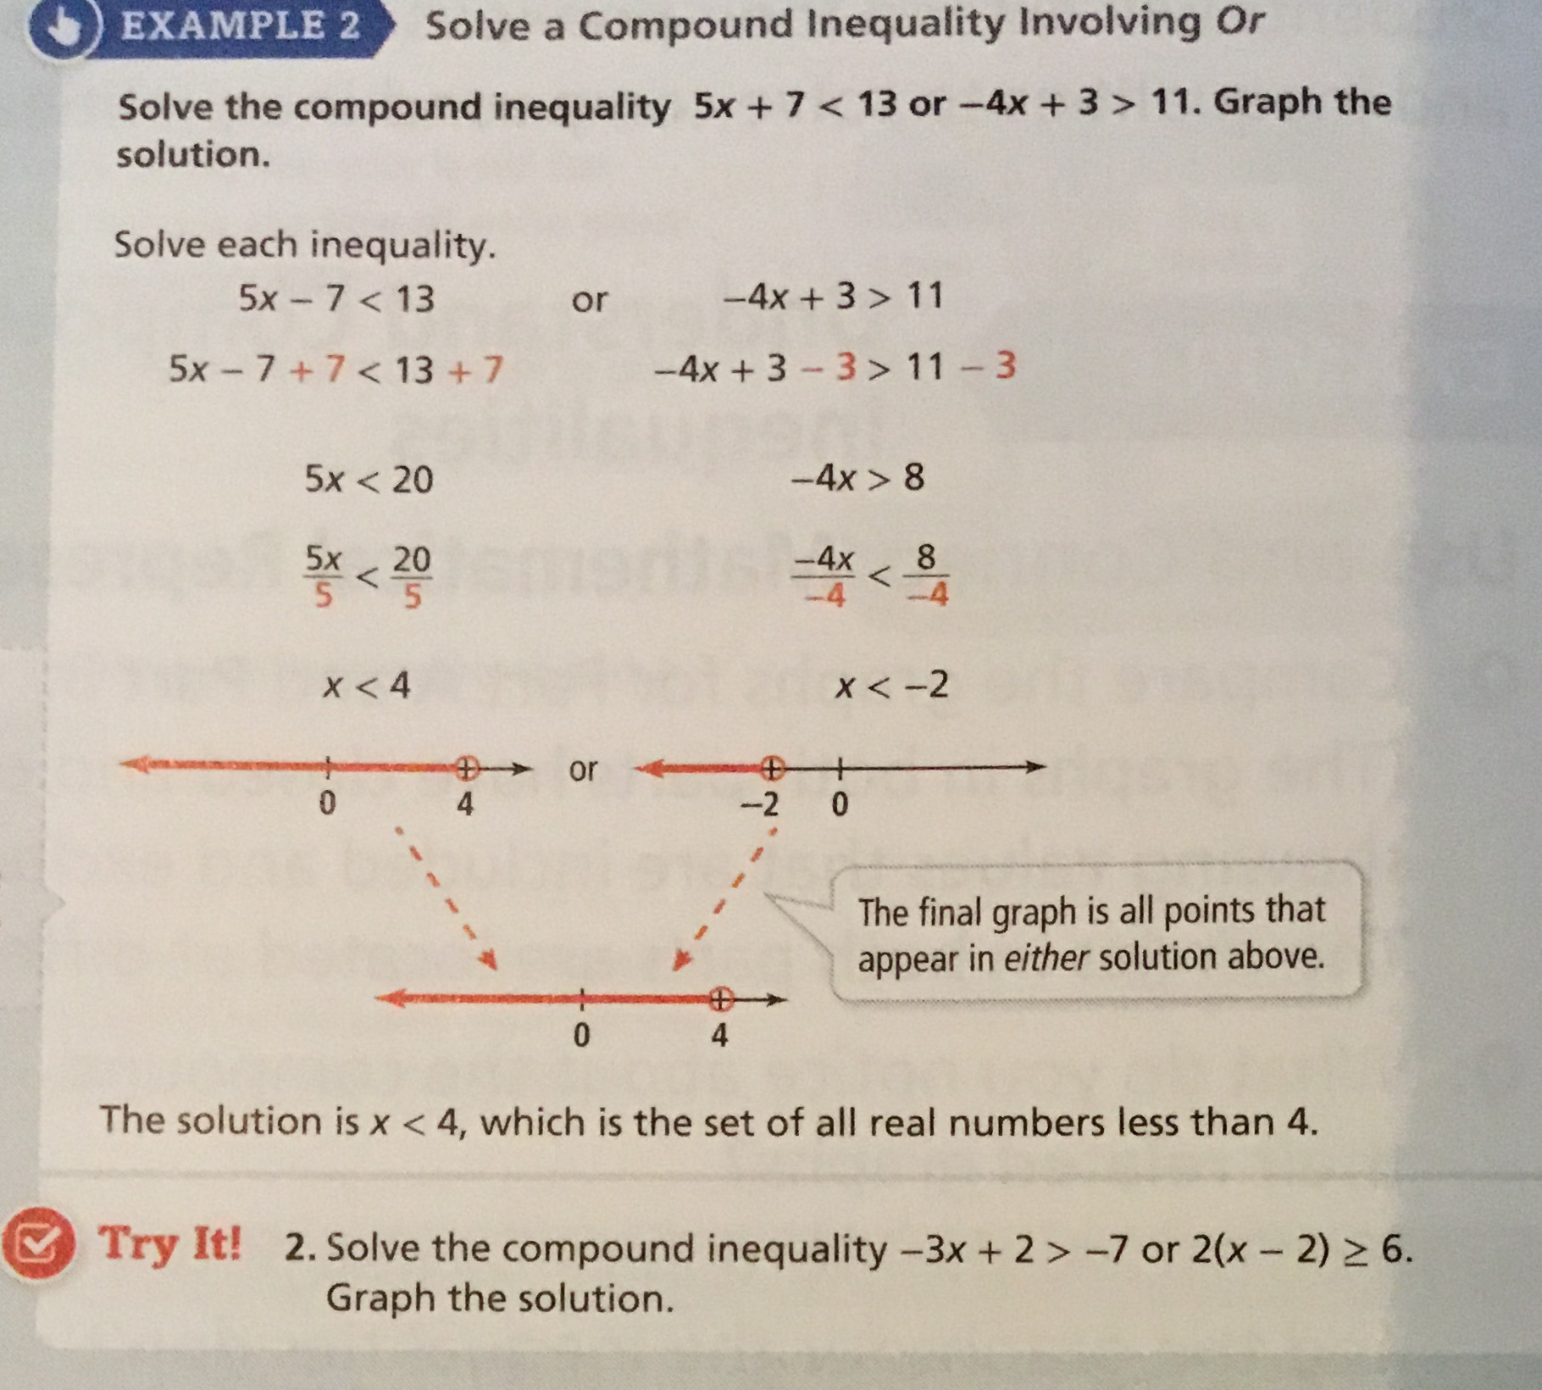

Slide 8
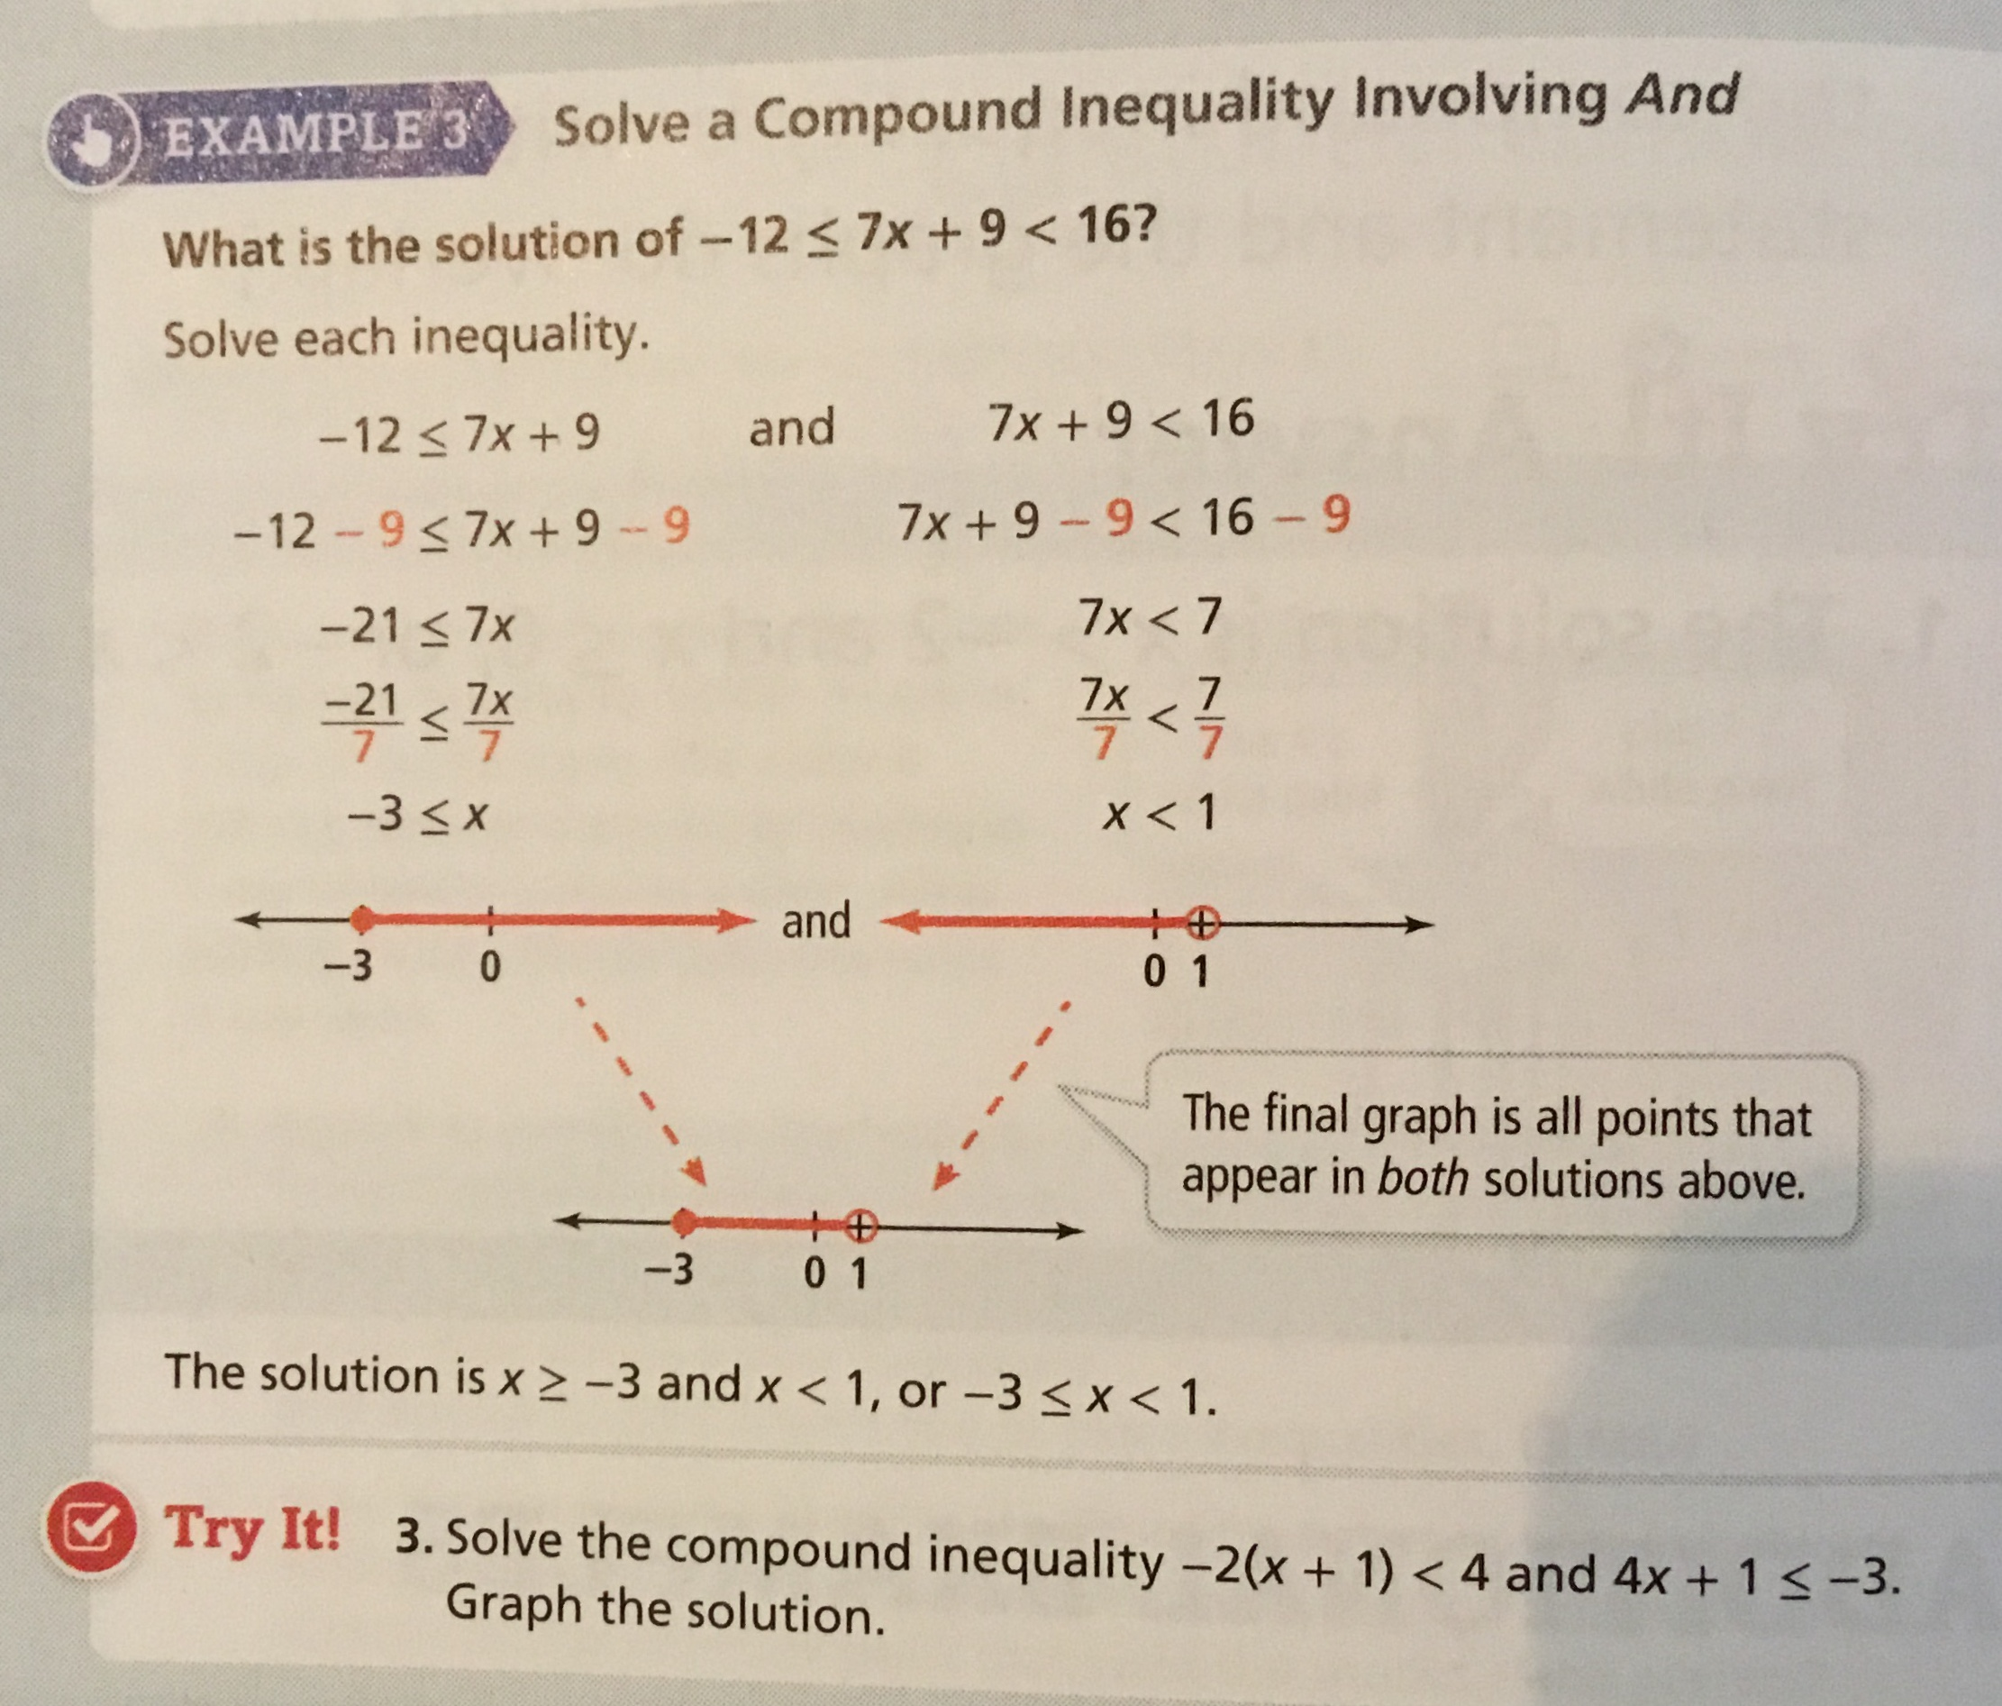

Slide 9
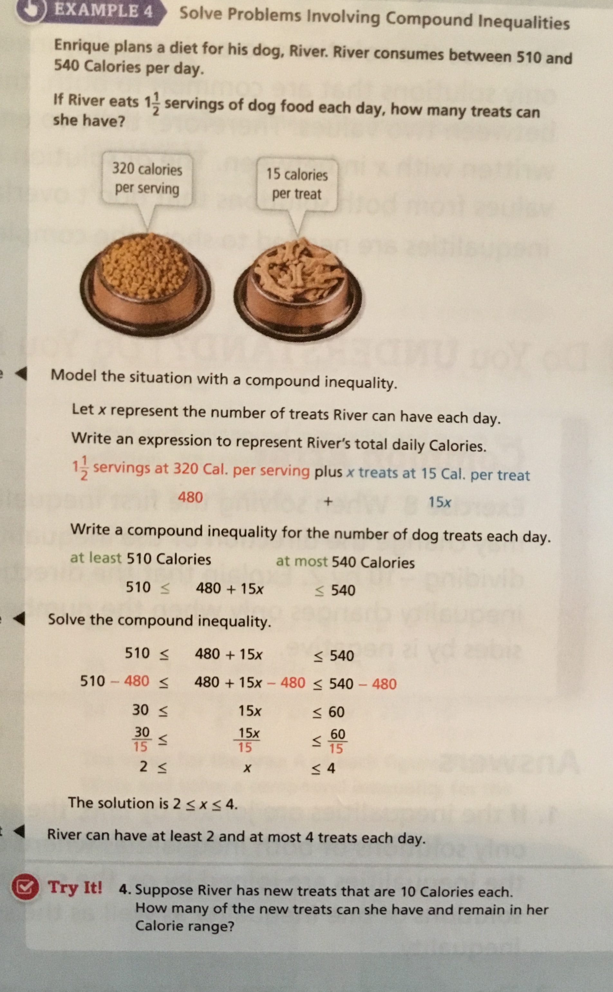

Slide 10
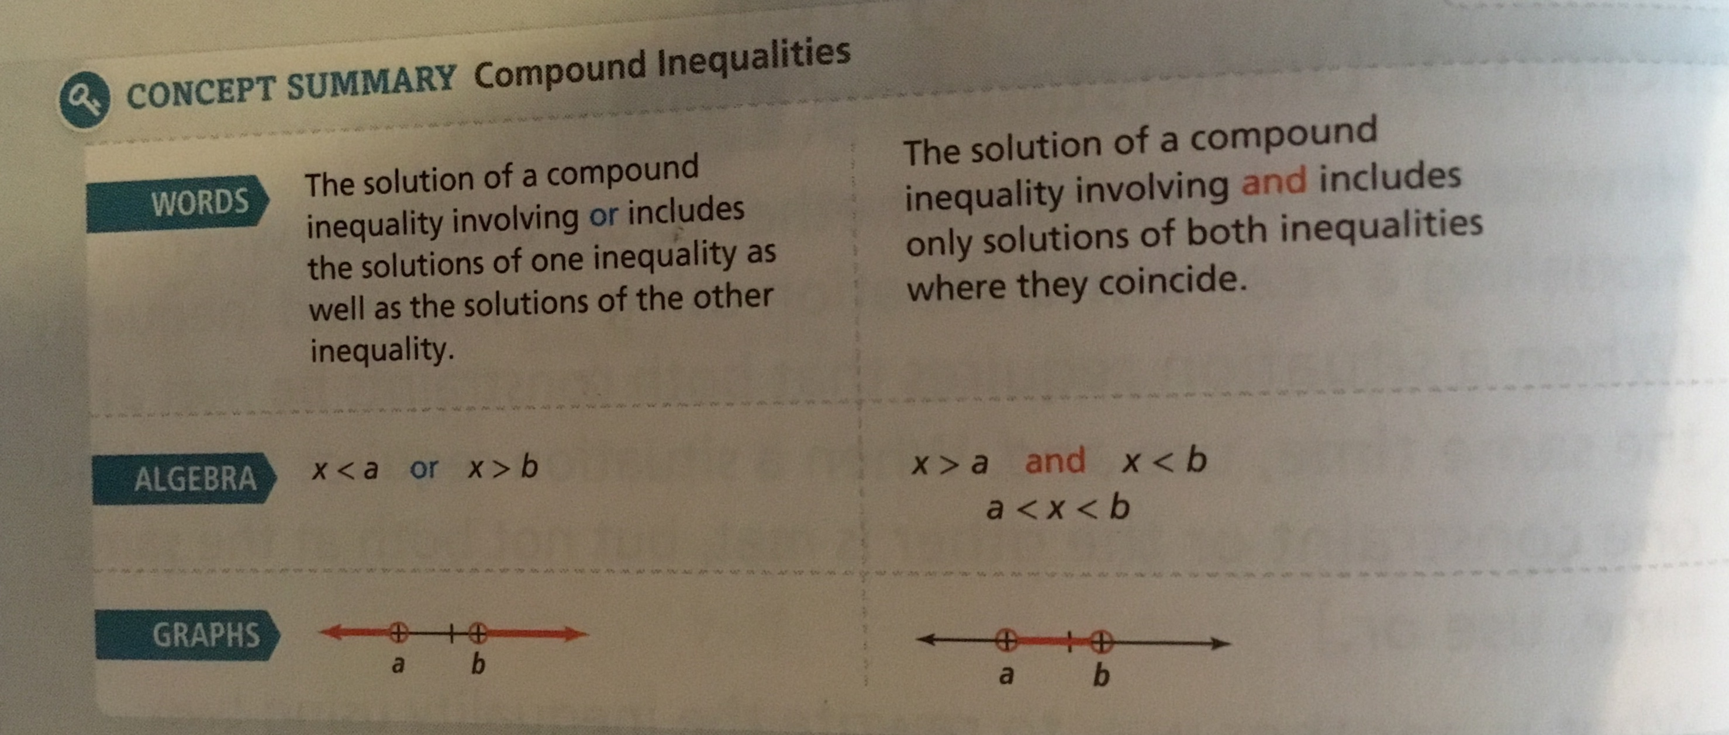

Slide 11
Exit Slip
Solve each compound inequality and graph the solution.
4x – 1 $>3 and −2\left(3x −4\right)≥−16$

