Slide 1
Converting between standard and slope intercept formulas
Algebra with Ms. Wiggins

Slide 2
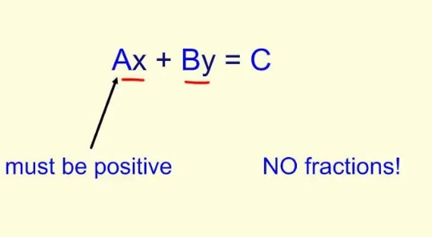
Standard Form of Equations

Slide 3
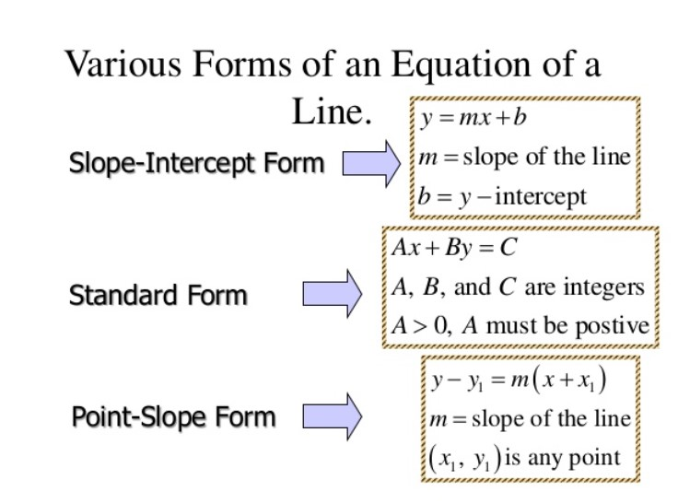

Slide 4
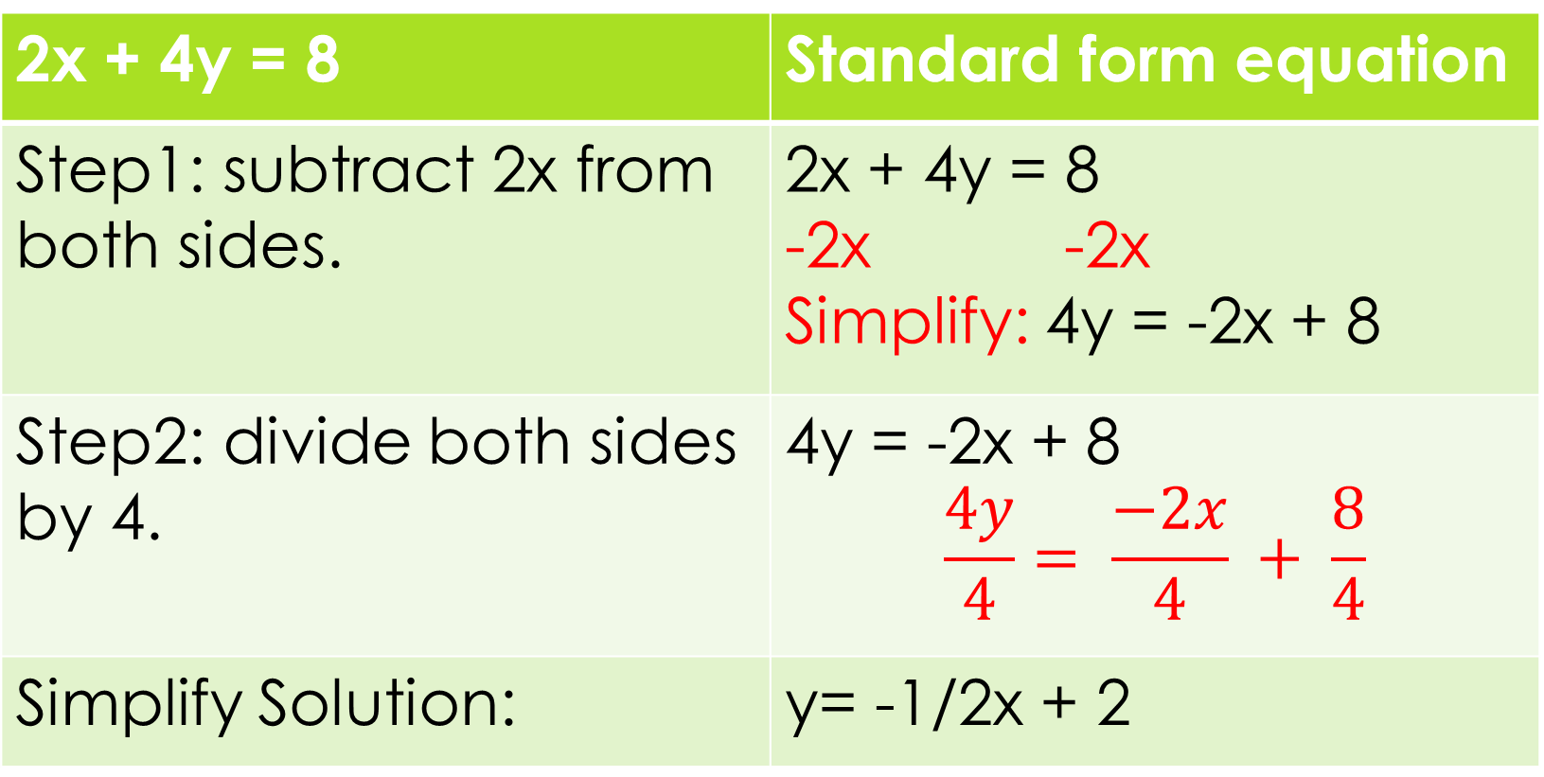
Example Video (Watch for problem below)
2x + 4y = 8 | Standard form equation
Step1: subtract 2x from both sides. | 2x + 4y = 8 -2x -2x Simplify: 4y = -2x + 8
Step2: divide both sides by 4. | 4y = -2x + 8 $$\frac{4y}{4}= \frac{−2x}{4} + \frac{8}{4}$$
Simplify Solution: | y= -1/2x + 2

Slide 5
Students Do
Write the following equations written in standard form in slope intercept form.
1. 5x – 7y = 12
2. 3x – 9y = -18

Slide 6
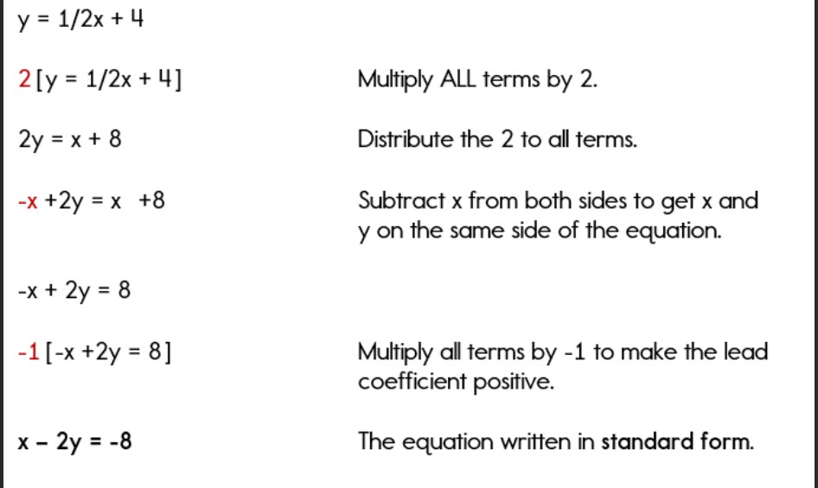
Converting Slope intercept into standard form

Slide 7
Converting slope intercept into standard form
VIDEO
WATCH

Slide 8
Students Do
1. y= 1/3x + 2
2. y= 5/7x + 12/7

Slide 9
Example Video’s
1. Example 1 Video
2. Example 2 Video

