Slide 1
Exponential Functions
Ms. Wiggins/Mr. Tillitt

Slide 4
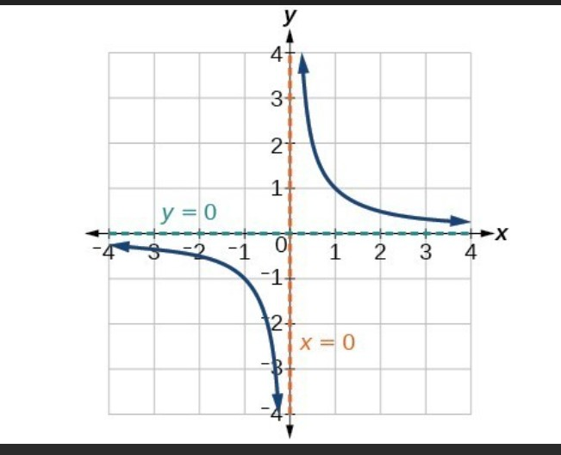

Slide 6
Graphs of Exponential f(x)’s
Functions will cross the y-axis at (0,1)
B controls how close the graph get to the y-axis
Function decreases ½^x
Function Increases 3^x

Slide 7
We Do
What’s the key features of the function 4(3)^x
Initial amount(cross the y-axis)?
Domain & Range?
Asymptote?
Function Increasing or Decreasing?

Slide 8
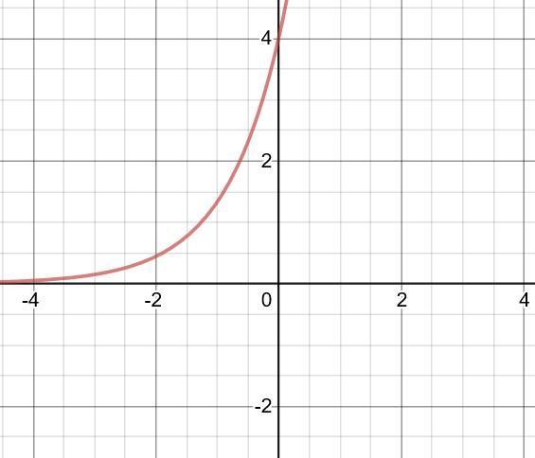
Y-intercept; where the graph cross the y-axis.
Take the last y-value and divide it by the y-value above it, you should get the same number every time.
Exponential Growth

Slide 9
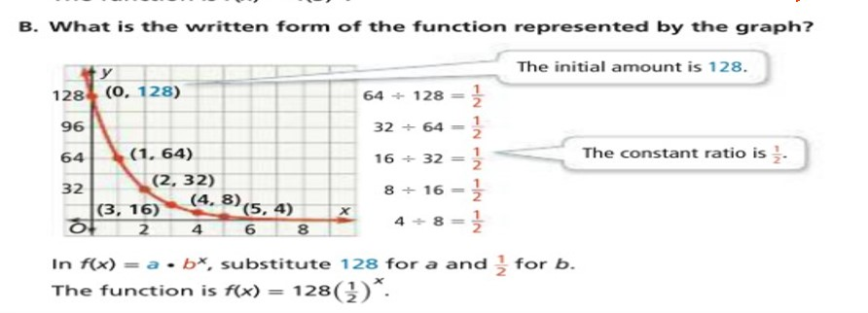
X | F(x)
0 | 128
1 | 64
2 | 32
3 | 16
4 | 8
5 | 4
The y-value are decreasing as x-values are increasing. Exponential Decay.
Step 1: Locate the initial amount
Step 2: Determine the constant ratio.
Step 3: Put initial amount and constant ratio into the formula f(x)=ab^x
f(x)=128(1/2)^x

Slide 10
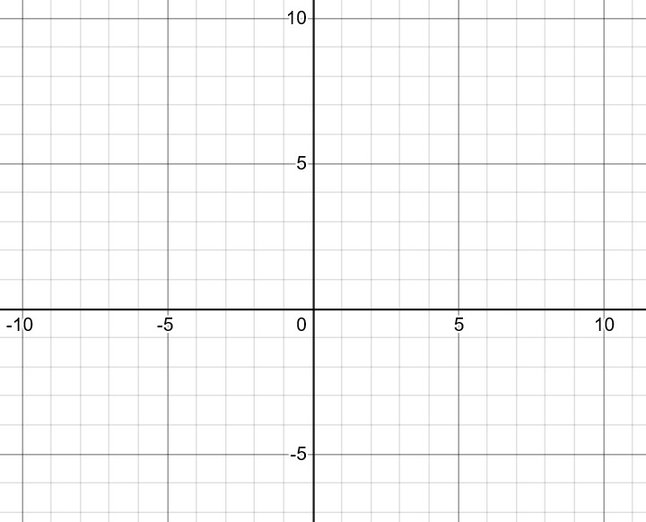
We Do
Let’s graph the exponential function f(x)=2^x
Step 1: Plug in values 1-4 for x and see what we get out for y-values.
Step 2: Graph the y-intercept and all the points from the table.
Step 3: Draw a curved line through the points
X | 2^x | F(x)
0 | 2^0 | 1
1 | 2^1 | 2
2 | 2^2 | 4
3 | 2^3 | 8
4 | 2^4 | 16

Slide 11
You Do
Initial amount?
Constant Ratio?
Domain?
Range?
Asymptote?
Write the equation!
Step 1: Identify initial amount/y-intercept
X | F(x)
0 | 4
1 | 2
2 | 1
3 | ½
4 | ¼
Step 2: Find the constant ratio. Divide the last y-value ¼ by the y-value above it ½. (1/4)/(1/2)=?
Step 3: Write equation from f(x)= ab^x.

Slide 12
Graph of Exponential f(x)’s
Red graph is ½^x(one half to the x power)
Graphs is further away from the y-aixs.
Blue graph is 10^x(ten to the x power)
Graph is closer to the y-axis.

Slide 16
Exponential Functions Part 2

Slide 17
Important Notes
It’s important to remember that the x exponent only applies to the constant ratio and not the initial amount.
6(1/3)^x
You can’t multiply 6 times 1/3 without raising (1/3)^x power first due to order of operations, exponents before multiplication. The value of x must be known to multiply initial amount(a) times constant ratio(b).

Slide 18
Real Life Example
Since the y-intercept is 1.5, then we know that x at that point is 0. (0,1.5)
Remember y=f(x), so we can write 1.5=a(b)^0.
b^0=1
At the point (1,0.6), so you can replace x & y
0.6=1.5(b)^1
0.6=1.5b
0.4=b
Y=1.5(0.4)^x
b.

Slide 20
Which table below represents an exponential function?
X | f(x)
0 | 0
1 | 1
2 | 4
3 | 9
4 | 16
x | f(x)
0 | 1/3
1 | 1
2 | 3
3 | 9
4 | 27
1/(1/3)=3
1/0=undefined
4/1=4
3/1=3
9/4=2.25
9/3=3
16/9=1.778
27/9=3
No constant rate or ratio.
Constant Ratio=3

Slide 21
Key Features of Exponential Functions
Range is y>0
0.8 to the 0 power is 1. f(x)=5(1); f(x)=5
Domain is all real numbers
The line is approaching the x-axis when y=0, but never touches the x-axis creating a asymptote approaching the line y=o.

Slide 22
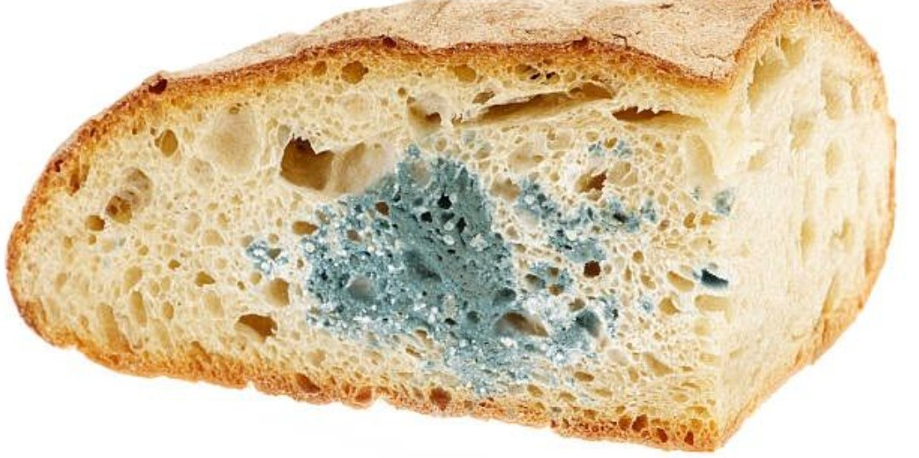
How exponential functions connect to real life!!
Have you noticed green colored mold on your bread spoiling your breakfast in a few hours? When you leave bread out for a long time, discoloration on bread occurs which is popularly known as bread mold. This bread mold is a microorganism which grows when the bread is kept at normal room temperature. The bread mold grows at a surprisingly alarming rate. This growth at a fast pace is defined as “Exponential Growth.”

Slide 23
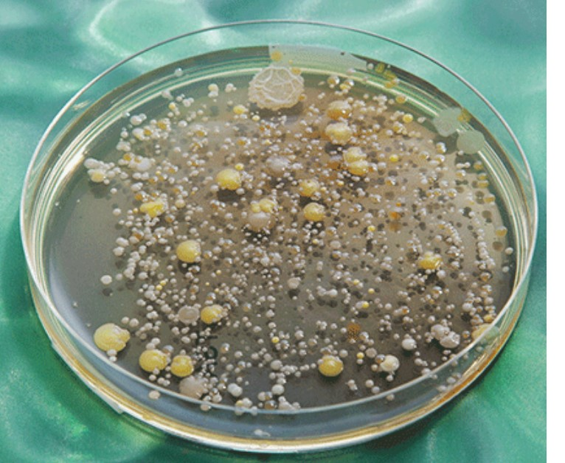
Exponential growth is the increase in number or size at a constantly growing rate. In exponential growth, a population’s per capita (per individual) growth rate stays the same regardless of the population size, making it grow faster and faster until it becomes large and the resources get limited.
During a pathology test in the hospital, a pathologist follows the concept of exponential growth to grow the microorganism extracted from the sample. Microbes grow at a fast rate when they are provided with unlimited resources and a suitable environment. It makes the study of the organism in question relatively easy and, hence, the disease/disorder is easier to detect.
Bacteria growth

Slide 24
Exponential Growth & Decay

Slide 25
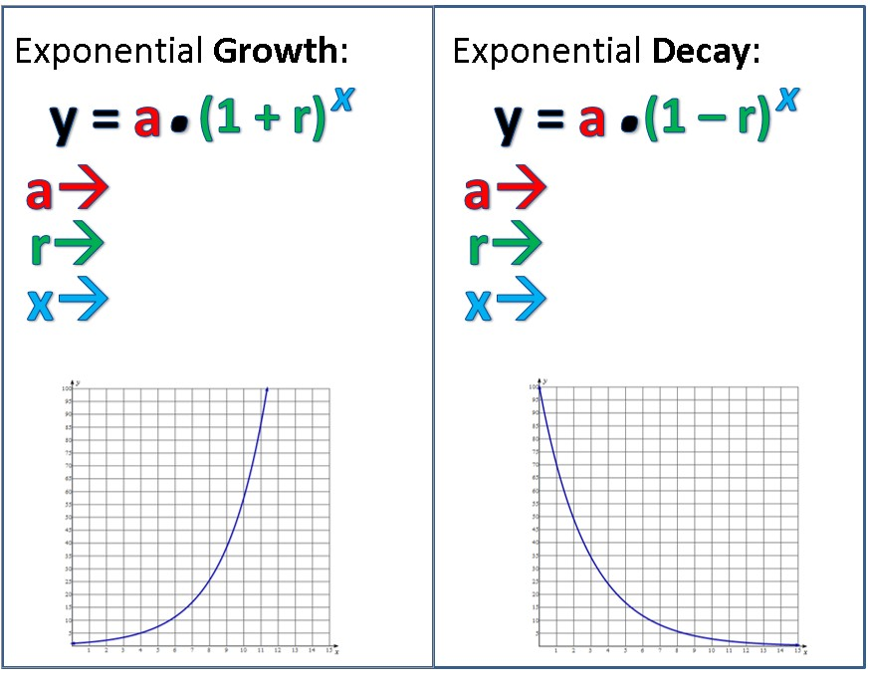

Slide 27
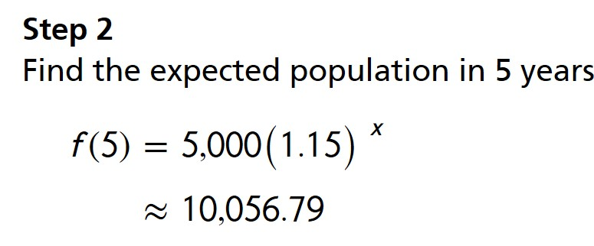

Slide 28
Exponential Decay
If Twin purchased a car for $20,000 and it depreciates by 15% per year, what will the value of his car be after 5 years?
f(x)=a(1-r)^x
a=20,000
b=(1 - .15) (.85)
x=5
f(x)=20,000(.85)^5
f(x)=8,874
After 5 years twin car will be worth $8,874; within 5 years his car depreciated by $11,126.

