Slide 1
Name:
Date:
Period:
Do First
A3B
A3B

Slide 2
Weekly Schedule
Monday – Tracking + Corrections
Tuesday – A11C – Exponential Growth & Decay
Wednesday – A2A – Parent Functions
Thursday – Final Objective Assessment → A11C, A2A, A3B
Friday – 2nd to Last Review! → A8A, A8B, A8C, A7A, A7B, A7C

Slide 3
Exponential Growth & Decay
May 7, 2013
Day 1: Monday 4/8 | Day 2: Tuesday 4/9 | Day 3: Wednesday 4/10 | Day 4: Thursday 4/11 | Day 5: Friday 4/12
Day 6: Monday 4/15 | Day 7: Tuesday 4/16 | Day 8: Wednesday 4/17 | Day 9: Thursday 4/18 | Day 10: Friday 4/19
Day 11:Monday 4/22 | Day 12: Tuesday 4/23 | Day 13: Wednesday 4/24 | Day 14: Thursday 4/25 | Day 15: Friday 4/26
Day 16: Monday 4/29 | Day 17: Tuesday 4/30 | Day 18: Wednesday 5/1 | Day 19: Thursday 5/2 | Day 20: Friday 5/3
Day 21: Monday 5/6 | Day 22: Tuesday 5/7 | Day 23: Wednesday 5/8 | Day 24: Thursday 5/9 | Day 25: Friday 5/10
Monday 5/13 World Geo STAAR | Tuesday 5/14 Regular Day | Wednesday 5/15 Biology STAAR | Thursday 5/16 ALGEBRA 1 STAAR!! | Friday 5/17
4 days until Algebra 1 STAAR!

Slide 4
Today’s Objective
I will identify equations that represent exponential growth & exponential decay.
I will answer questions using equations of exponential growth & exponential decay.

Slide 5
Agenda
Do First (8)
Notes/Guided Practice (25)
On Your Own (20)
Exit Ticket (3)

Slide 6
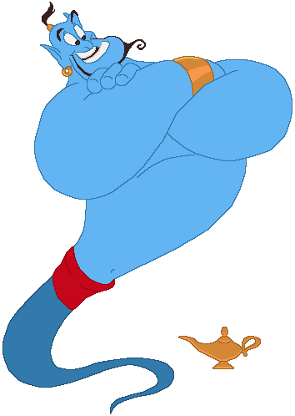
Would you rather…
A genie pops out of a lamp and presents you with the following choice:
Receive $50,000 now
Or
- For the next month, start with 2 pennies on Day 1 and then receive 2 more pennies on Day 2, 4 more pennies on Day 3, 8 more pennies on Day 4, etc?

Slide 7
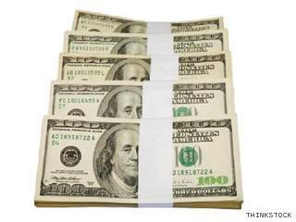
Choice 1 – By the end May you would have…
$50,000

Slide 8
Or…
- For the next month, start with 2 pennies on Day 1 and then receive 2 more pennies on Day 2, 4 more pennies on Day 3, 8 more pennies on Day 4, etc?

Slide 9
Choice 2 – By the end May you would have…
$0.02
$1,310.72
1
2
3
4
5
6
7
8
9
10
11
12
13
14
15
16
17
18
19
20
21
22
23
24
25
26
27
28
29
30
31
$0.04
$2,621.44
$0.08
$5,242.88
$0.16
$10,485.76
$0.32
$20,971.52
$0.64
$41,943.04
$1.28
$83,886.08
$2.56
$167,772.16
$5.12
$335,554.32
$10.24
$671,088.64
$20.48
$1,342,177.28
$40.96
$2,684,354.56
$81.92
$5,368,709.12
$163.84
$10,737,418.24
$327.68
$21,474,836.48
$655.36

Slide 10
Choice 2 – By the end May you would have…
$21,474,836.48
(Twenty-one million, four hundred seventy-four thousand,
eight hundred thirty-six dollars and forty-eight cents)
It would be like having this amount:
$50,000

Slide 11
….about 421 times…

Slide 12
Today’s Objective
I will identify equations that represent exponential growth & exponential decay.
I will answer questions using equations of exponential growth & exponential decay.

Slide 13
Exponential Growth:
Exponential Decay:
.
.
y =
a
x
y =
a
x
(1 + r)
(1 – r)
a→
a→
r→
r→
x→
x→
Notes:
a = initial amount before measuring growth/decay r = growth/decay rate (often a percent) x = number of time intervals that have passed

Slide 15
Example 1
Lucas invests $500 in Apple. His investment has an annual growth rate of 10%.
Write a function of exponential growth that represents y, the value of Lucas’ investment, after x number of years.
Use this function to determine the total value of Lucas’ investment after 8 years.
How much will he have after 20 years?

Slide 16
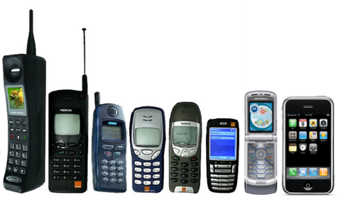
The evolution of cell phones

Slide 17
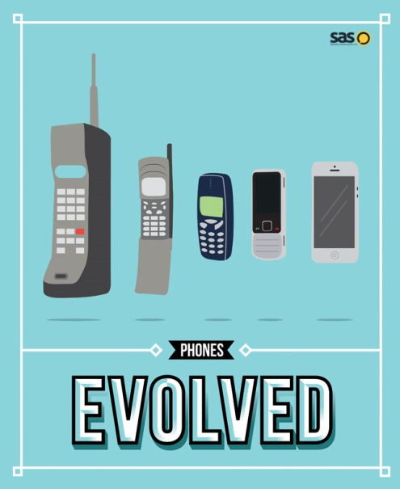
Example 2
In 1998, there were 50 cell phone users in Mr. Hill’s small town of Anniston, Alabama. The number of users increased by 75% per year after 1998.
Write a function of exponential growth that represents y, the number of cell phone users in Anniston, Alabama, after x number of years.
At this rate, how many cell phone users were there in 2003 (round to the nearest whole number)?
If the population of Mr. Hill’s town is roughly 13,000, by what year will every person own a cell phone?

Slide 18
Example 2
In 1998, there were 50 cell phone users in Mr. Hill’s small town of Anniston, Alabama. The number of users increased by 75% per year after 1998.
Sketch a graph that represents this function.
Year | # of users

Slide 20
Example 3
Estephanie competed in the National Texting Competition. Including her, there were a total of 65,536 participants. During each round of the tournament, half of the participants were eliminated.
Write a function of exponential decay that represents y, the number of participants remaining after, after x number of rounds.
At the end of round 3, how many people were left in the competition?
Estephanie made it to the final round! What round number will this be?

Slide 21
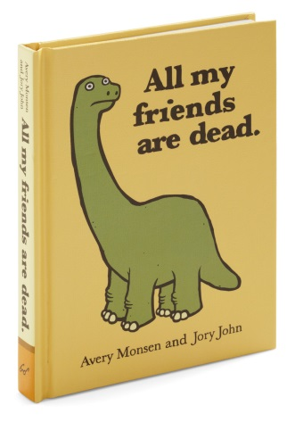
Example 4
Oh no! The dinosaurs are dying at an exponential rate! There are currently 80 dinosaurs remaining, and each month, 25% of the dinosaurs say “Adios.”
Write a function of exponential decay that represents this sad, sad situation.
After how many months will there only be about 14 dinosaurs still alive?
About how many months will pass before this book is written?

Slide 22
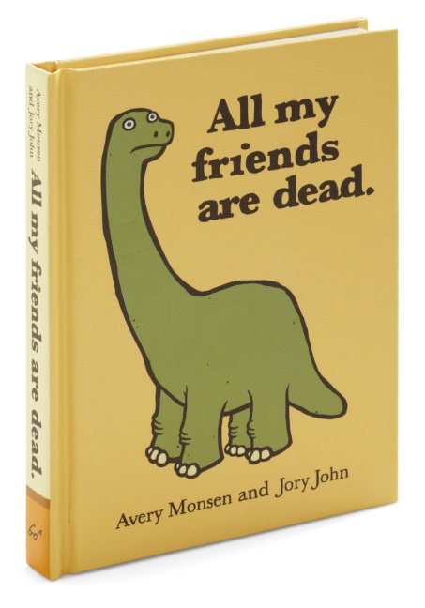
Example 4
Oh no! The dinosaurs are dying at an exponential rate! There are currently 80 dinosaurs remaining, and each month, 25% of the dinosaurs say “Adios.”
Sketch a graph that represents this function.
# of months | # of dinosaurs remaining

Slide 23
On Your Own

Slide 24
STAAR Prep Exit Ticket 5.9
A11C
Name:
Date:
Period:
Mastery:
0% 50% 100%
1.
A population of 1500 deer decreases by 1.5% per year. At the end of 10 years, there will be approximately 1290 deer in the population.
Which function can be used to determine the number of deer, y, in this population at the end of t years?
2.
Which equation of exponential growth best represents the following table of values?

