Slide 1
Mathematical Expressions
Algebra I
Ms. Wiggins

Slide 2
Expressions
Expressions are operations of numbers and letters written as words and/or numbers and letters as one term.
Expressions can be written algebraically using numbers and letters
Algebraic Example: 2 + b Written Example: two more than some number b

Slide 4
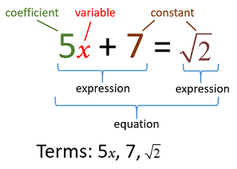

Slide 5
