Slide 1
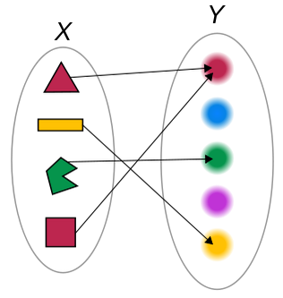
Introduction to Functions
Relations vs. Functions
Input – output
Independent Variable – Dependent Variable

Slide 2
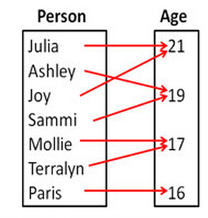
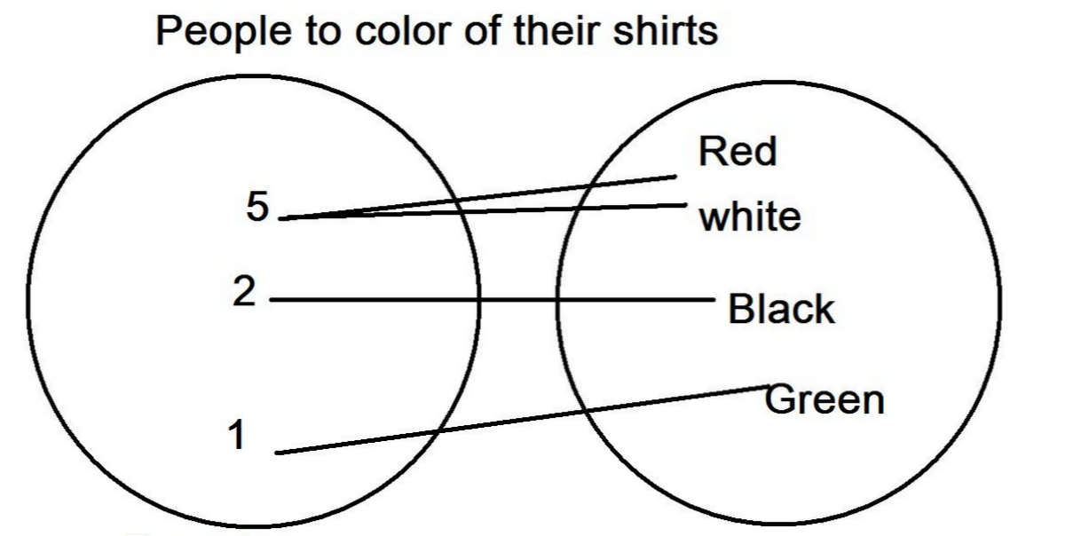
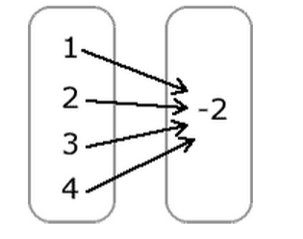
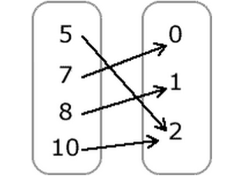
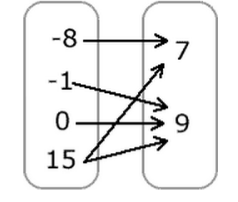
Mapping Diagram

Slide 4
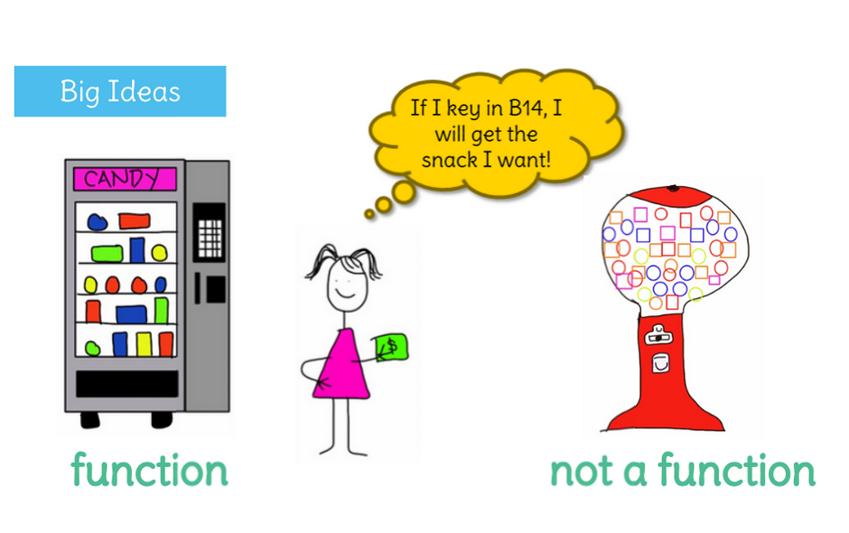

Slide 7
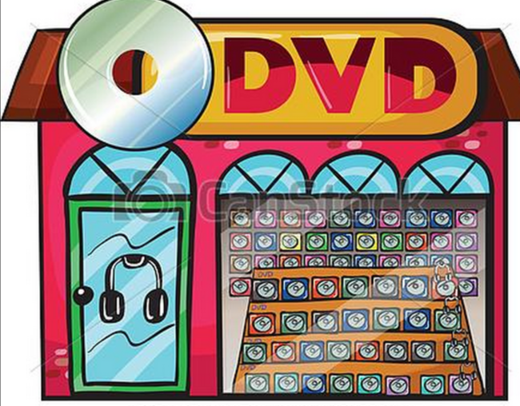

Slide 11
A function is actually a "special" kind of relation because it follows an extra rule. Just like a relation, a function is also a set of ordered pairs; however, every x-value must be associated to only one y-value.
Suppose we have two relations written in tables,

Slide 13
Paul has already eaten 2 pieces of candy, then he eats 3 pieces of candy each minute after that.
1. Write an expression that represents the following situation.
2. Create a chart/table of values with 5 input values.
3. Is the relation a function? Why or why not?
4. Write 5 ordered pairs
5. Identify the domain and range of the function.

