Slide 1
Solving Linear Equations with variables on both sides
Algebra I
Ms. Wiggins

Slide 2
Standards
HSA.CED.A.1 Create equations and inequalities in one variable and use them to solve problems.
HSA.REI.B.3. Solve linear equations and inequalities in one variable, including equations with coefficients represented by letters.

Slide 3
Objective
Students will be able to use the properties of equality to solve linear equations with a variable on both sides. Identify whether equations have one solution, infinitely many solutions, or no solution.

Slide 4
Vocabulary
Like terms
Properties of equality
Solution of an equation
identity

Slide 5
Do Now
How many solutions does an equation such as 5x=5x have if the equation is true for all values of x?
One solution
Two solution
No solution
Infinitely many solution

Slide 6
Essential Questions
How do you create equations with a variable on both sides and use them to solve problems?
Why does it make sense to describe an equation that has infinitely many solutions as an identity?
Does it matter what side of the equation collects the variable terms?

Slide 7
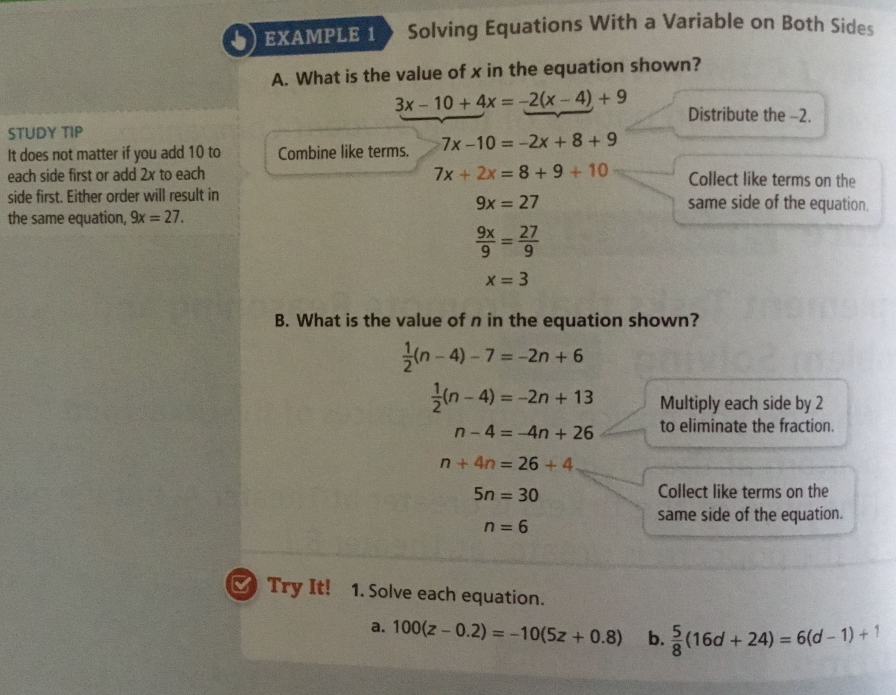

Slide 8
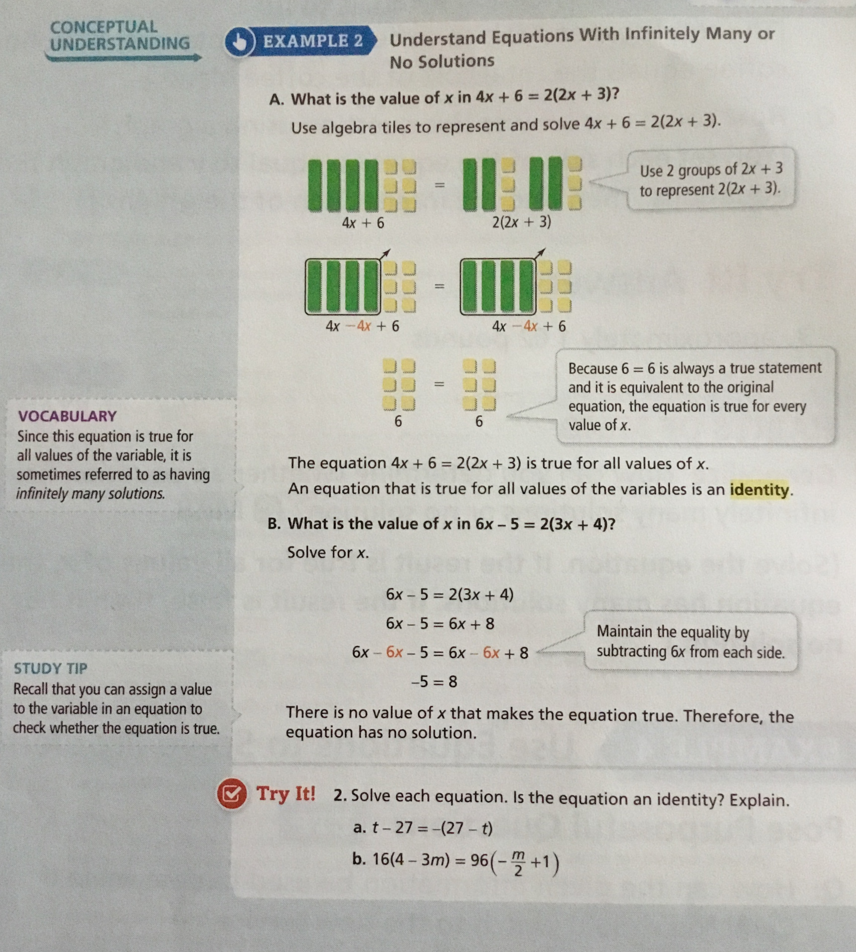

Slide 9
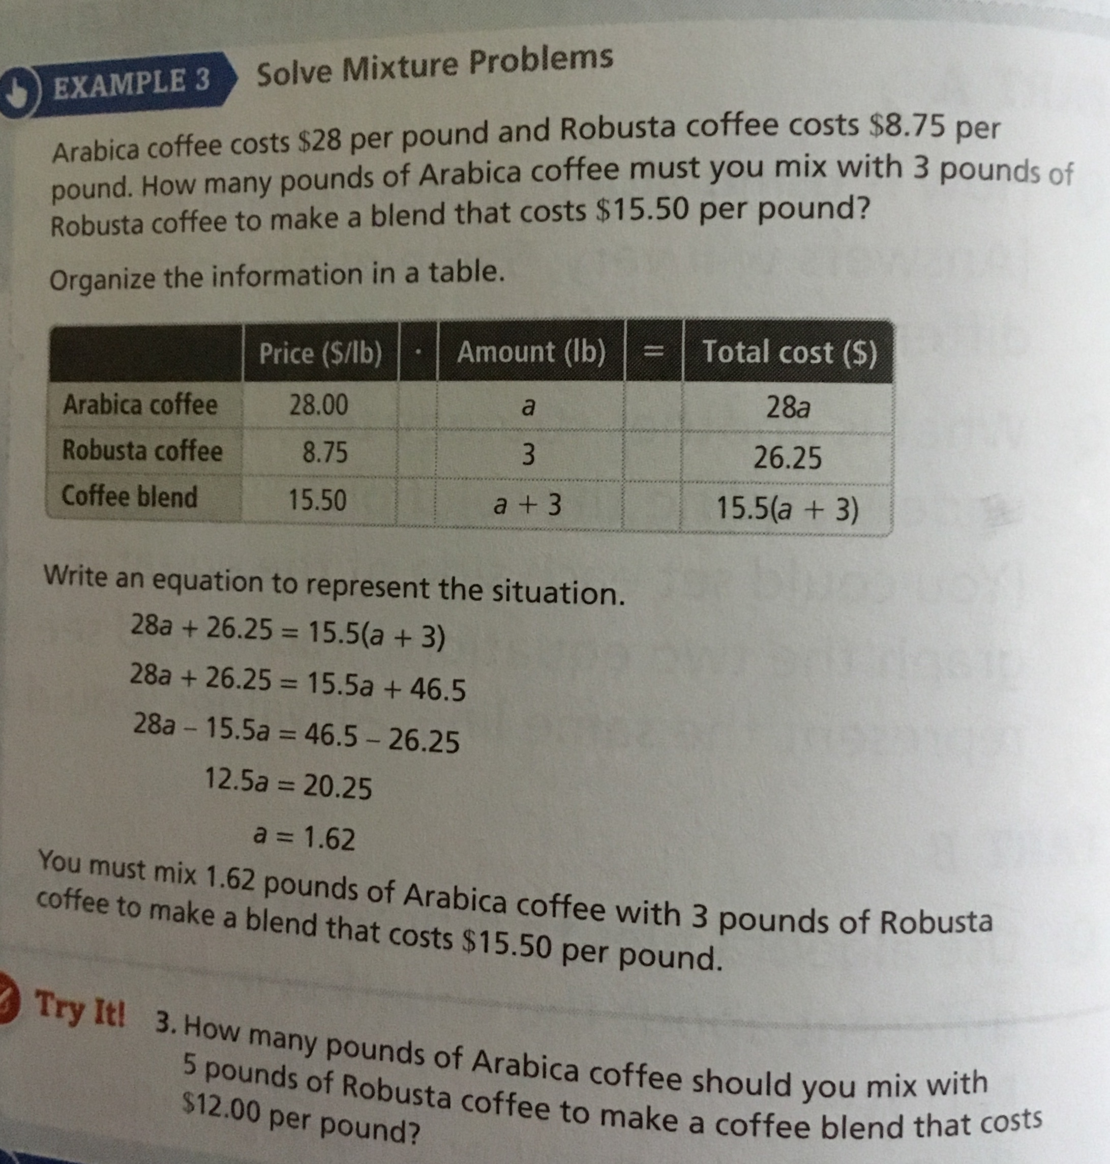

Slide 10
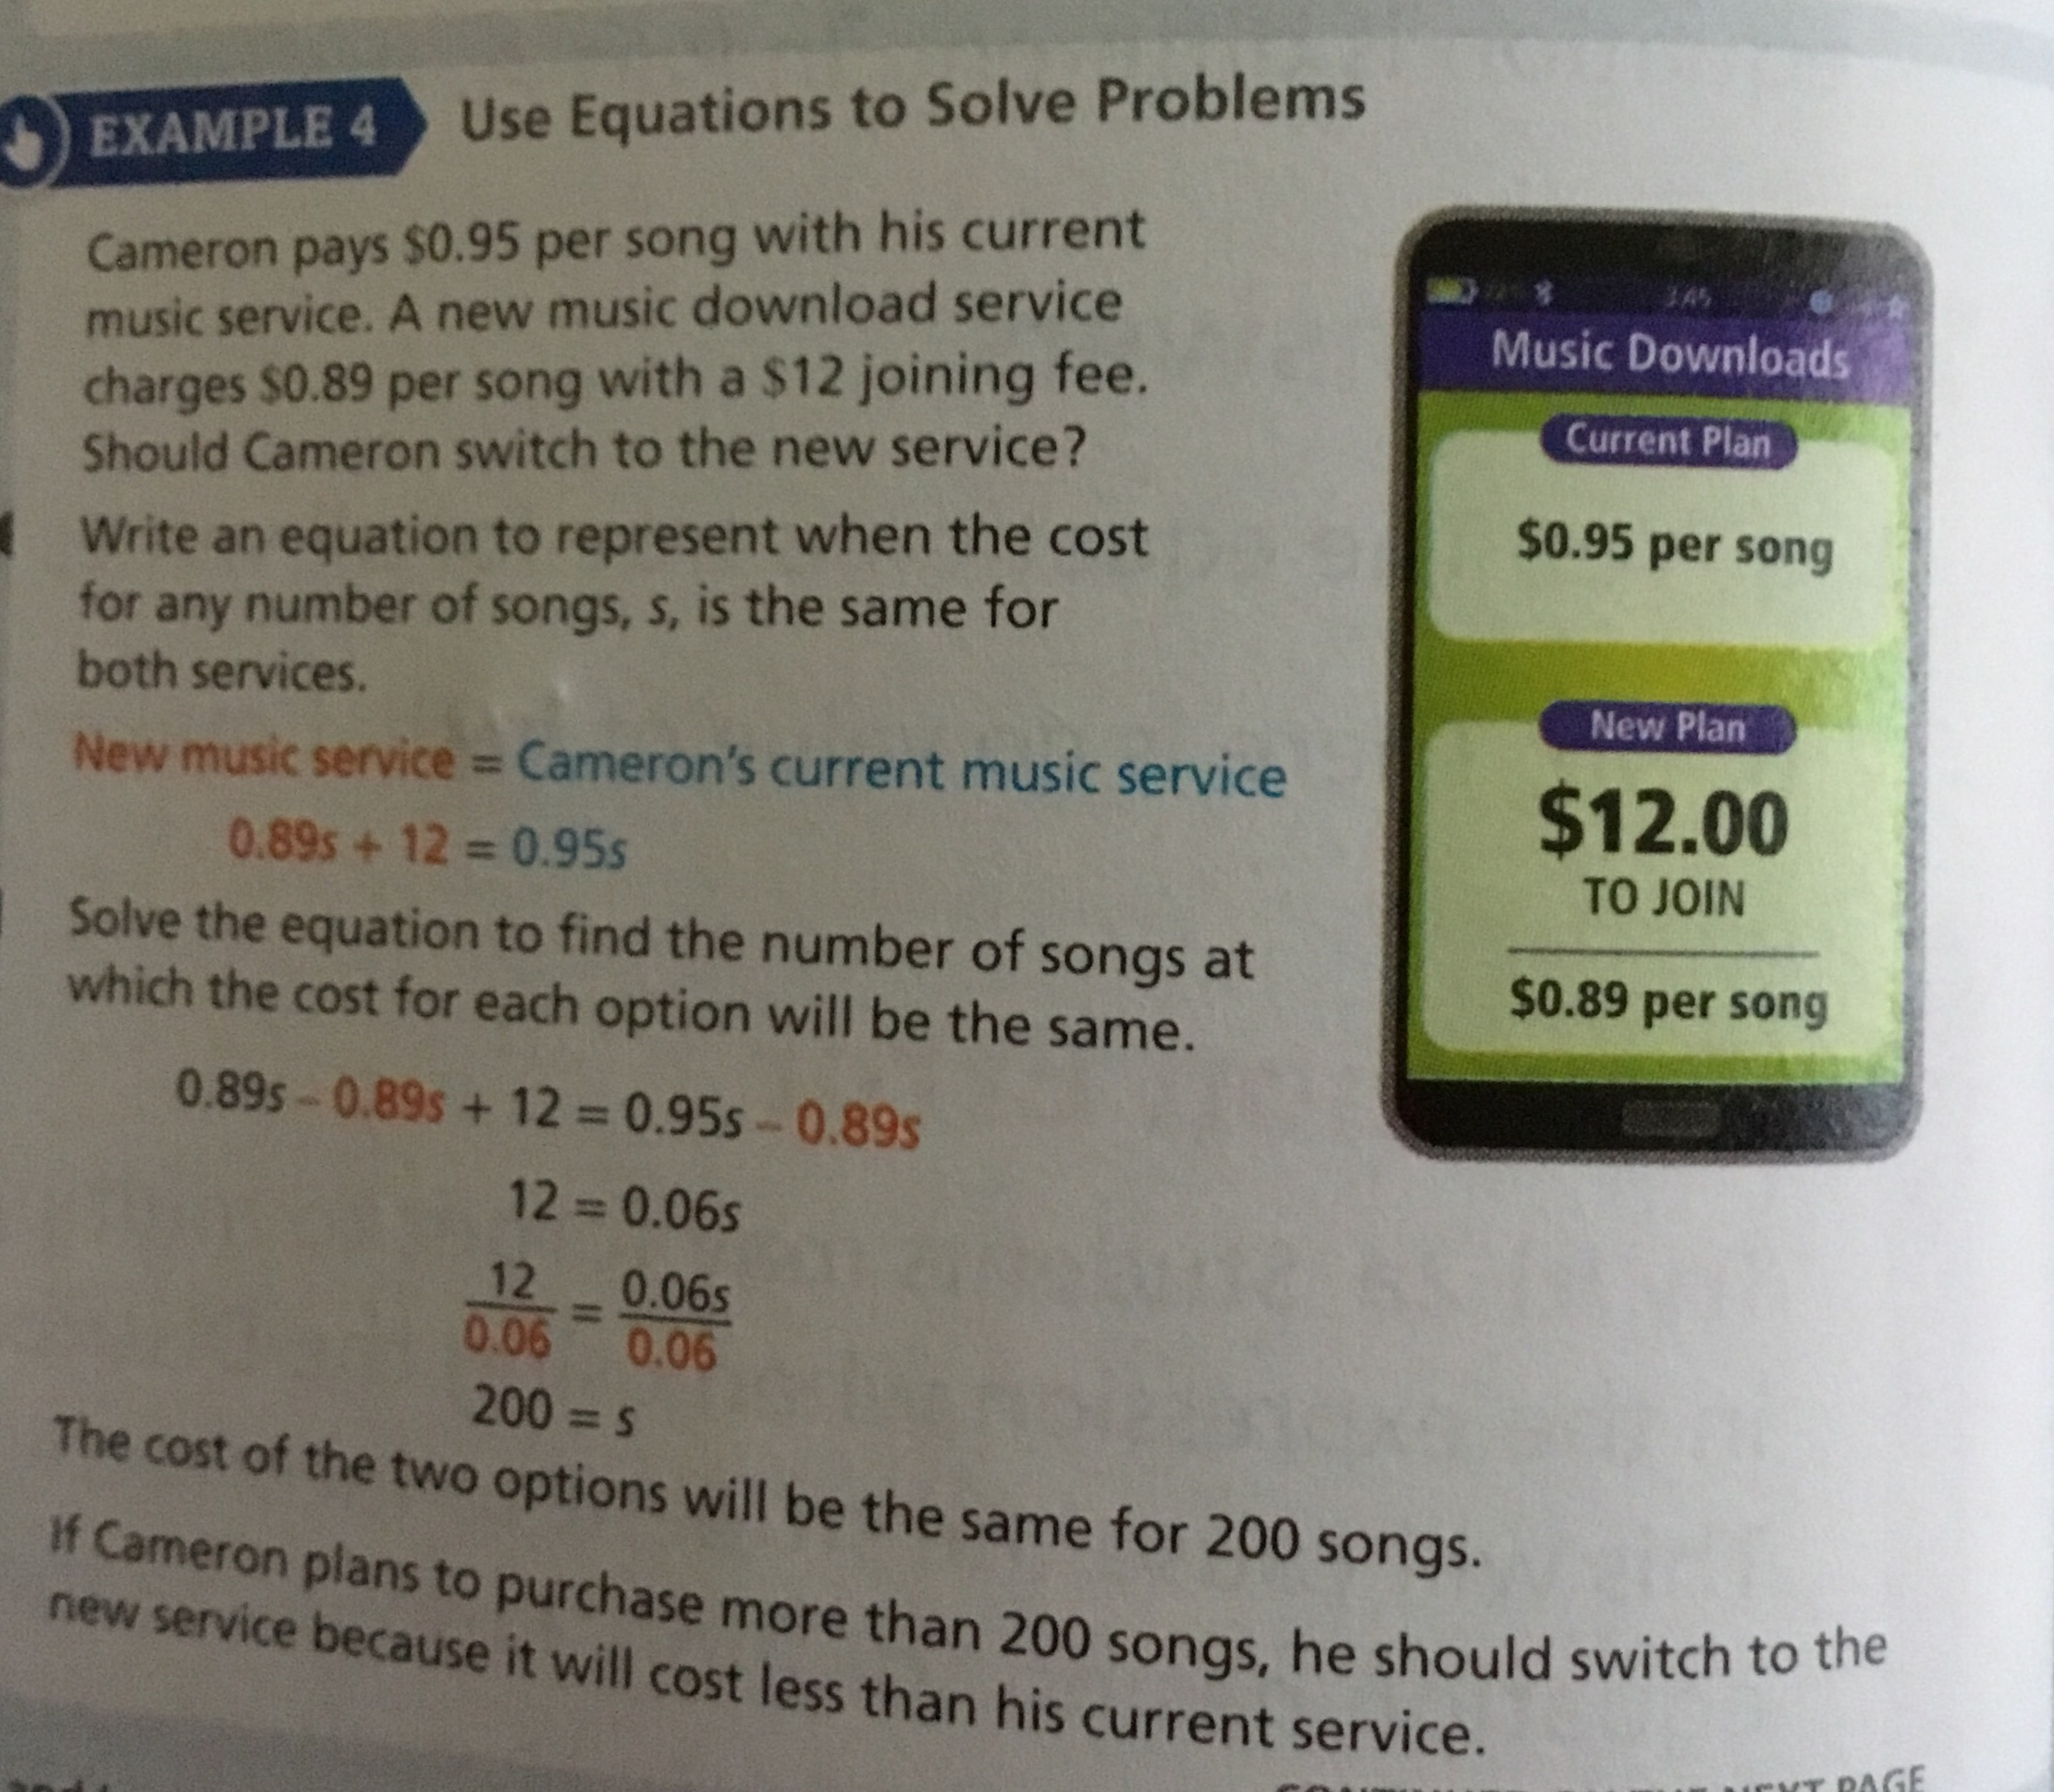

Slide 13
Exit Slip
Solve 3x + 2 = 4x - 1

