Slide 1
All Real Numbers Standard: HSN.RN.B.3
Objective:
Students will be able to identify and classify numbers as rational or irrational
Find the sum or product of two rational numbers and explain why the sum or product is rational
Find the sum or product of rational and irrational numbers and explain when the sum or product is irrational.

Slide 2
Essential Understanding
The set of real numbers includes both rational and irrational numbers. The sum or product of two rational numbers is rational. The sum of a rational and irrational number is irrational; and the product of an nonzero rational number an irrational number is irrational.

Slide 3
Vocabulary
Irrational number
Rational number
Real number
Element of a set
Set
subset

Slide 4
Do Now
Students will analyze a bowl of candy in class and explain it’s description.
Teacher will separate the candy according to color in two different piles A & B, then students will categorize each pile of candy.
Questions
Compare the bowl of candy to it’s separate piles of candy and explain the difference
Are the piles of candy A & B subsets of the bowl of candy? Explain.

Slide 5
Direct Instruction
Powerpoint
Lesson Videos

Slide 6
All Real Numbers
A real number is any number on the infinite number line
In mathematics, a real number is a value of a continuous quantity that can represent a distance along a line. ... The real numbers include all the rational numbers, such as the integer −5 and the fraction 4/3, and all the irrational numbers, such as √2 (1.41421356..., the square root of 2, an irrational algebraic number).

Slide 7
Rational & Irrational Numbers
Real numbers are divided into two different subsets of numbers rational & irrational numbers.
An irrational number is a number that cannot be expressed as a fraction for any integers and Irrational numbers have decimal expansions that neither terminate nor repeat.
An rational number is a number that can be expressed as a fraction for any integers and rational numbers have decimal expansions that terminate or repeat.

Slide 9
The sum or product of two rational numbers is rational
Examples:
2 + 1 = 3 (both numbers 1 & 2 are rational and the sum equals 3 which is rational)
2 x 1 = 2 (both numbers 1 & 2 are rational and the product is 2 which is rational)

Slide 10
The sum or product of rational & irrational numbers is irrational.
Examples:
$\frac{1}{2}$(rational #) + $√2$ (irrational #)= $\frac{1+2√2}{2}$ (1.914213562….irrational)
$π\text{(}\text{irrational}\text{ \#)}∙2\text{(}\text{rational}\text{ \#)}=2π$ (6.283185307…irrational)
Zero is the only rational number that can multiplied to a irrational number and the product is rational
Example: 0 $∙π=0$

Slide 11
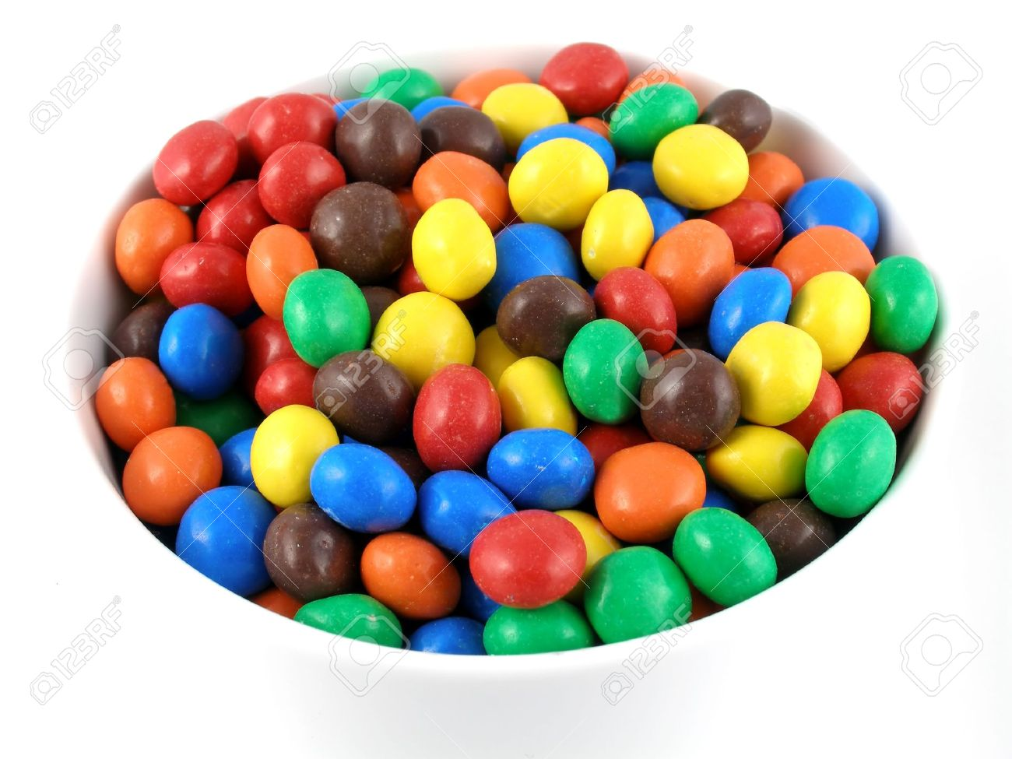
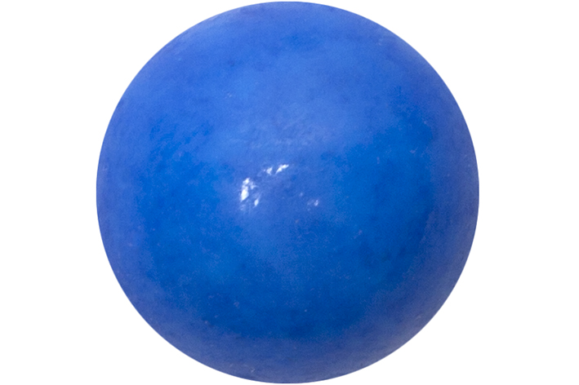
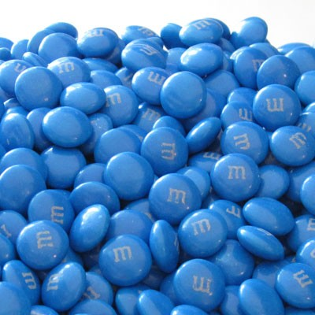
Sets & Subsets
A set is a collection of objects such as numbers(like the bowl of candy from the do now).
A element of a set is an object in that set (like a blue candy piece from the bowl of candy)
Subset is a small group of the objects taken from the larger set of objects (like the pile of blue candy only taken from the bowl of candy)

Slide 12
Integers from least to greatest
$\frac{1}{2}, 2^{2},−16, 20,\sqrt{2, }0$,-1
50, -50, 30, 20, $\sqrt{64}$

Slide 13
Concept Summary

