Slide 1
Linear Equations
Chapter 2/unit 1
10-09-2017

Slide 2
Objective:
Student’s will be able to write liner equations in two variables using slope-intercept form to represent the relationship between two quantities.

Slide 3
Slope-intercept form
Y = mx + b
m- represents the slope of the line
X -the x-coordinate of ordered pairs (x,y)
B -the y-intercept of the graph; the line intersects the y-axis at the point (0, b).

Slide 4
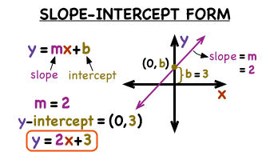

Slide 5
Essential Understanding
The slope-intercept form of a linear equation is used when you know the slope and the y-intercept of the line.

Slide 6
Essential Question
What information does the slope-intercept form of a linear equation reveal about a line?
The slope of the line and the y-intercept are given by the slope-intercept form, so the line is easily graphed.

Slide 7
Essential Question
What is the relationship between the b-value of the equation and the graph?
The b-value of the equation represents the y-intercept of the graph. The line intersects the y-axis at (0,b).

Slide 8
Pearson realize examples
Concept summary online

