Slide 1
Systems of Linear Equations
Algebra 150
Ms. Wiggins
1/17/18

Slide 2
Agenda
Do Now/ 5 minutes
EOC Pre-Assessment/ 15 minutes
Objective/ 2 minutes
Pre-Assessment/ 15 minutes
Direct Instruction/ 20 minutes
Independent Assignment/ 30 minutes
Exit Slip/ 3 minutes

Slide 3
Objective
Students will be able to graph systems of linear equations in two variables to find an approximate solution.

Slide 4
Pre-Assessment 15 minutes
Pearsonrealize.com/Login and complete on paper.

Slide 5
Vocabulary
Intersection
Solution of a system of linear equations
System of linear equations

Slide 6
Essential Understanding
The intersection of the graphs of a pair of linear equations is used to estimate the solution to the system. If two lines intersect at a point, there is exactly one solution. If two lines are the same, there are infinitely many solutions. If two lines are parallel, there is no solution.

Slide 7
Essential Question How can you use a graph to illustrate a solution to a system of linear equations?
Graph the two linear equations, and wherever the equations intersect is the solution of the system.

Slide 8
Example 1 page 143
Pearsonrealize.com
Desmos.com
Y = -2x – 4
Y = 0.5x + 6

Slide 9
Students Do
Use a graph to solve the system of linear equations. Graphing Calculators
Y = 1/2x – 2
Y = 3x – 7
Use a graph to solve the system of linear equations. Graphing Calculators
Y = 2x + 10
Y = -1/4x + 1

Slide 10
Example 2
Page 144

Slide 11
Students Do
Y = 1/2x + 7
4x – 8y = 12

Slide 12
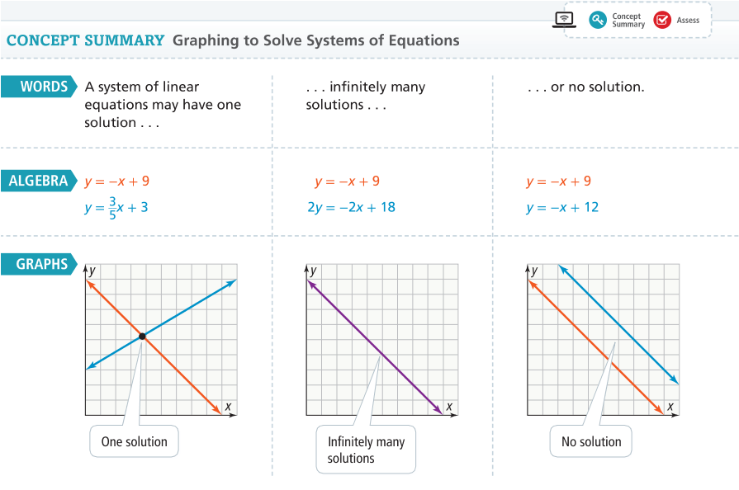
Concept Summary

Slide 13
Independent Assignment 30 minutes
Pearsonrealize.com
Do You Understand?
Do You Know How?
4-1 Additional Practice

Slide 14
Thursday’s Agenda 1/18/18
Do Now
Understanding Check
Review yesterdays’ assignment solutions
Notebook Anchor Charts
Gallery Walk
Review for Quiz

Slide 15
Understanding Check
Review the solutions for independent assignment

Slide 16
Friday’s Agenda 1/19/2018
Do Now
Mathspace.co
Review Gallery Walk Answers

Slide 17
DOL
Students will create anchor charts for concept summary on systems of linear equations using a problem from independent assignment.

